Slide 1
Open Access and you: a relationship with promise
Exeter University Open Access Week event, 24 October 2012
Alma Swan
SPARC Europe
Enabling Open Scholarship
Key Perspectives Ltd

Slide 2
Old paradigms of research dissemination
Use of proxy measures of an individual scholar’s merit is as good as it gets
The responsibility for disseminating your work rests with the publisher
The printed article is the format of record
Other scholars have time to search out what you want them to know

Slide 3
New paradigms of research dissemination
Rich, deep, broad metrics for measuring the contributions of individual scholars
Effective dissemination of your work is now in your hands (at last)
The digital format will be the format of record (is already in many areas)
Unless you routinely publish in Nature or Science, ‘getting it out there’ is up to you

Slide 4
Open Access
Immediate
Free (to use)
Free (of restrictions)
Access to the peer-reviewed literature (and data)
Not vanity publishing
Not a ‘stick anything up on the Web’ approach
Moving scholarly communication into the Web Age

Slide 5
Open Access: how
Open Access journals (www.doaj.org)
Open Access repositories
Open Access monographs

Slide 6
Open Access journals
Content available free of charge online
In many cases, free of restrictions on use too
Some charge at the ‘front end’
More than half do not levy a charge at all
Around 8500 of them
Listed in the Directory of Open Access Journals (DOAJ: www.doaj.org)

Slide 7
Open Access repositories
Digital collections
Most usually institutional
Sometimes centralised (subject-based)
Interoperable
Form a network across the world
Create a global database of openly-accessible research
Currently c2500

Slide 8
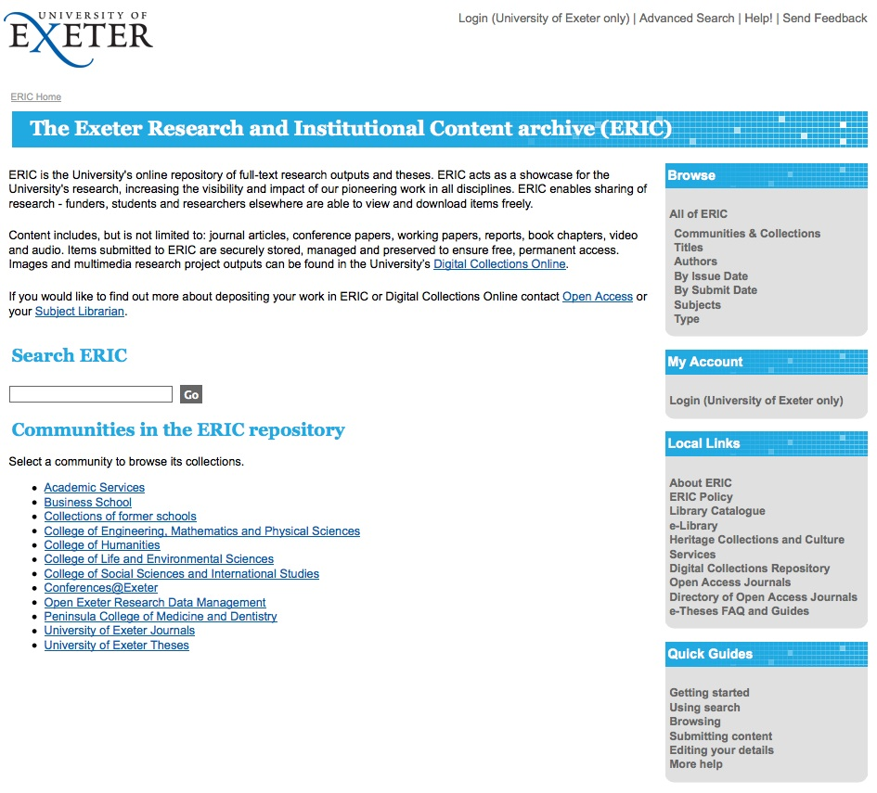
Here’s one

Slide 9
Author advantages from Open Access
Visibility
Usage
Impact
Personal profiling and marketing

Slide 10
Visibility

Slide 11
An author’s own testimony on open access visibility
“Self-archiving in the PhilSci Archive has given instant world-wide visibility to my work. As a result, I was invited to submit papers to refereed international conferences/journals and got them accepted.”

Slide 12
Professor Martin Skitmore
School of Urban Design, QUT
“There is no doubt in my mind that ePrints [university repository] will have improved things – especially in developing countries such as Malaysia … many more access my papers who wouldn’t have thought of contacting me personally in the ‘old’ days.
While this may … increase … citations, the most important thing … is that at least these people can find out more about what others have done…”

Slide 13
Usage

Slide 14
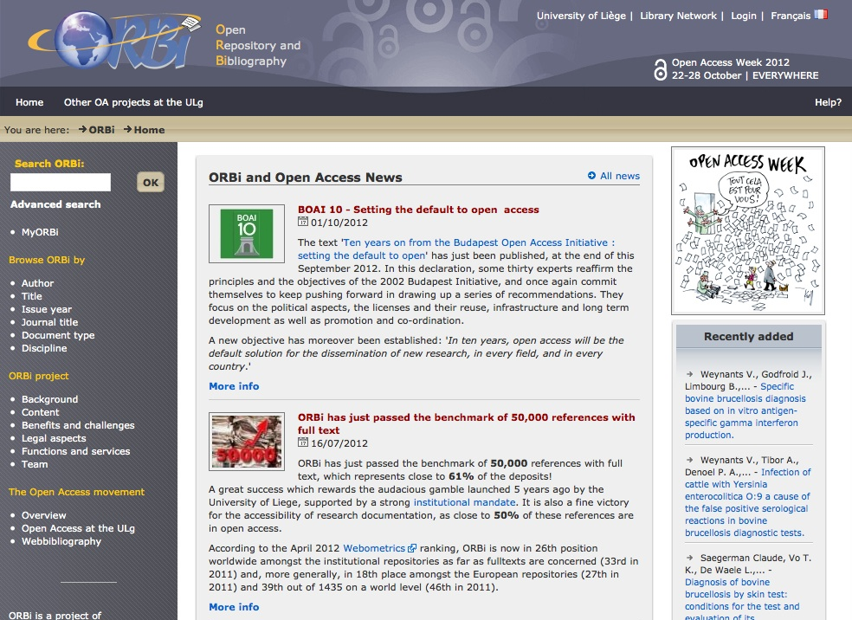
A well-filled repository

Slide 15
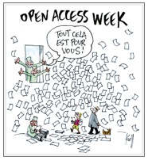
Open Access Week at Liege

Slide 16
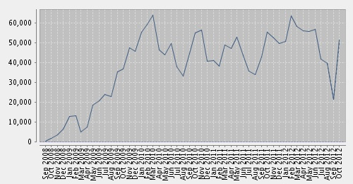
And it gets used

Slide 17
Notes:
17

Slide 18
Download timeline

Slide 21
Impact

Slide 23
Engineering
Citations
Data: Gargouri & Harnad, 2010

Slide 24
Clinical medicine
Citations
Data: Gargouri & Harnad, 2010

Slide 25
Social science
Citations
Data: Gargouri & Harnad, 2010

Slide 26
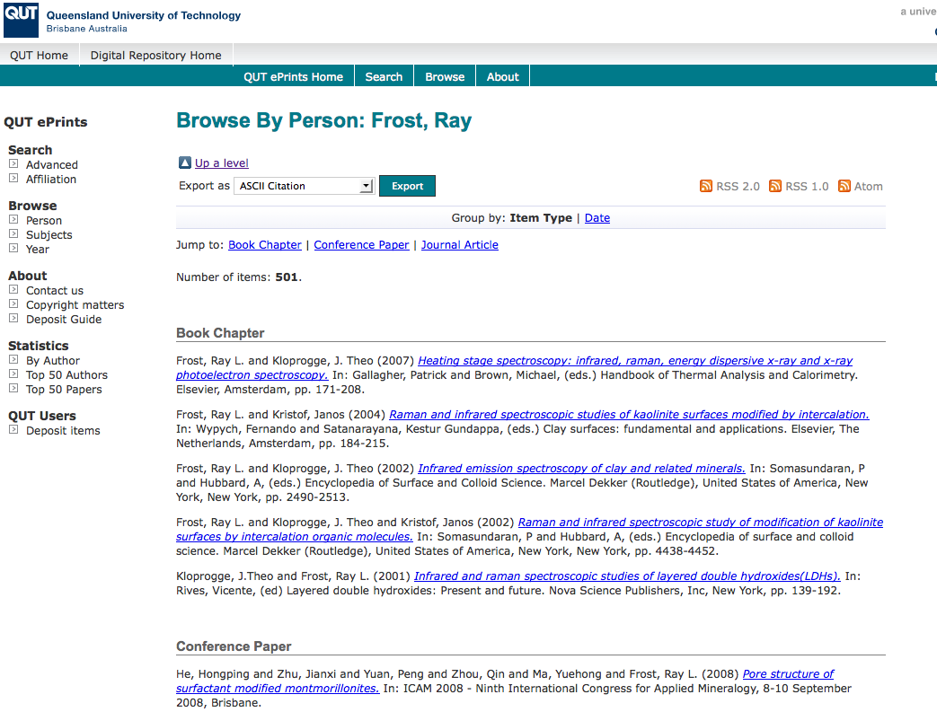
What OA means to a researcher

Slide 27
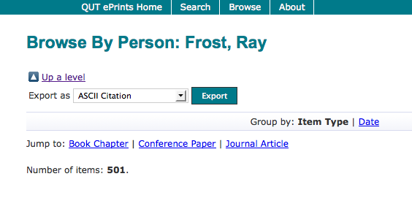

Slide 28
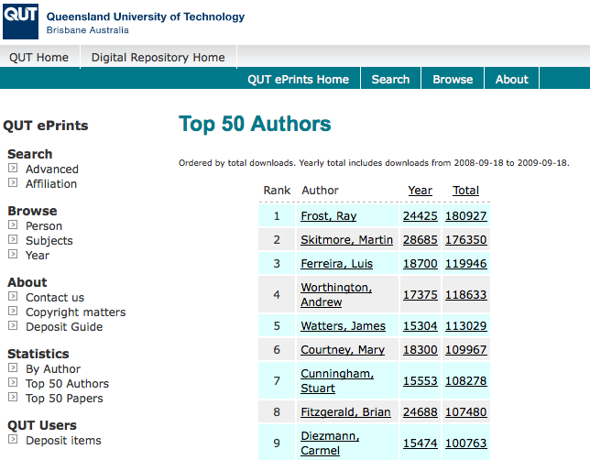

Slide 29
Top authors (by download)

Slide 30
Ray Frost’s impact

Slide 31
Top authors (by download)

Slide 32
Martin Skitmore
(Urban Design)

Slide 33
Cardiology
“We are looking for experts in cardiac surgery and medical imaging research who could collaborate with us, as well as provide data such as echocardiographic images … if you are interested in this project, perhaps you’d be interested in collaborating with us?”

Slide 34
Law
“...a few weeks ago X ... was contacted by a firm of solicitors in Melbourne. They are representing pro bono (for no payment) a number of Aboriginal people .... The lawyers had seen our article on eprints [university repository] and asked X if he would give expert evidence to a hearing in the Federal Court this month.”

Slide 35
Media studies
[from a county library] “Just wanted to write and tell you that I was able to supply a young client with high quality information on the representation of youth in the Australian media because of your e-prints [institutional repository] archive.”

Slide 36
Design
“QUT ePrints has allowed me to discover new research partners, or contacts in the community. Just last week, the General Manager of Sustainable Development from an Australian rural industry called me – based on reading one of my research papers in ePrints.
He loved what he read ..... and we are now in discussion about how we can help them measure their industry’s social impacts.”

Slide 37
Profiling and marketing

Slide 38
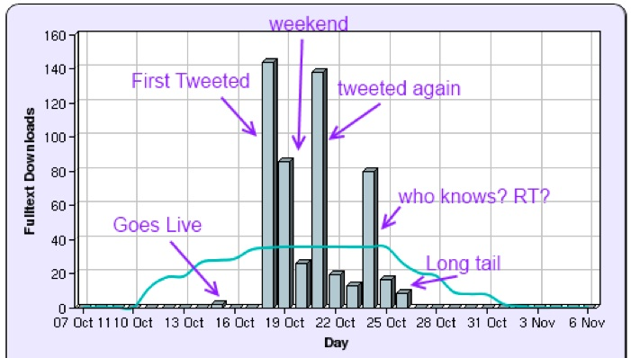
Melissa Terras

Slide 39
“It's a really good thing to make your work Open Access. More people will read it than if it is behind a paywall. Even if it is the most downloaded paper from a journal in your field, Open Access makes it even more accessed.”
  Melissa Terras, University College London

Slide 40
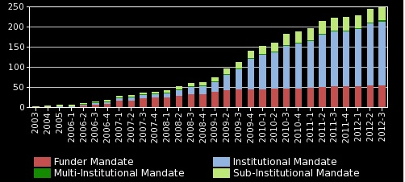
Open Access mandatory policies

Slide 41
Daniel Coit Gilman
First President, Johns Hopkins University
“It is one of the noblest duties of a university to advance knowledge and to diffuse it, not merely among those who can attend the daily lectures, but far and wide.”

Slide 42
Resources
General, comprehensive resource on Open Access:
OASIS
(Open Access Scholarly Information Sourcebook)
www.openoasis.org
For policymakers, institutional managers:
EOS
(Enabling Open Scholarship)
www.openscholarship.org

Slide 43
Thank you for listening
aswan@keyperspectives.co.uk
www.keyperspectives.co.uk
www.openoasis.org

