Slide 1

How to Organise your Files and Folders
Gareth Cole. Data Curation Officer. 6th October 2014

Slide 2

Introductions
• Who are we?
• Who are you and why are you here?

Slide 3

Today’s Session
File naming
Versioning
File directories
Data/file formats
Storage and backup of data

Slide 4

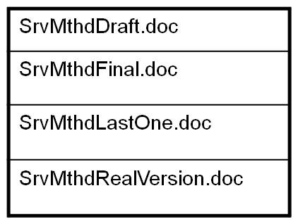
Which is the Final Version?

Slide 5

The Benefits of Organising Files and Folders
Future proof your data
Meet funder obligations
Save time
Easier collaboration; ensure that you work on correct version
Good research practice
Archive correct version

Slide 6

File Naming
File name = principal identifier of file
Easy to: identify, locate, retrieve, access
Provides context e.g.:
version number e.g. FoodInterview_1.1
date e.g. HealthTest_2011_04_06
content description e.g. BGHSurveyProcedures
creator name e.g. CommsPlanGJC

Slide 7
File Naming: Best Practice
Brief and relevant
Limit special characters, dots or spaces
For separation use underscores _
Name independent of location
Date: YYYY_MM_DD
Have a System!
Consistent and logical naming system
Develop a system with colleagues for shared data

Slide 8
Version Control Tools/Strategies
Record file status/versions
Record relationships between files
  e.g. data file and documentation; similar data files
Keep track of file locations
  e.g. laptop vs PC; office vs home

Slide 9

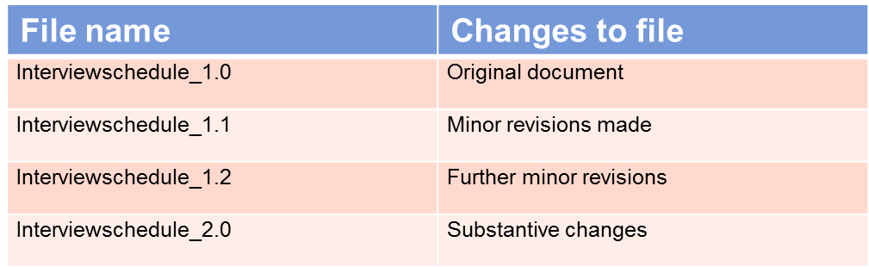
Version Control: Single User
• File naming; unique file name with date or version number
Version control table or file history alongside data file

Slide 10

Version Control: Multiple Users
Control rights to file editing: read/write permissions
e.g. Microsoft Office
Versioning/file sharing software:
e.g. Google Drive, Amazon S3
Merging of multiple entries/edits

Slide 11

Version Control: Multiple Locations
  Synchronise files
      e.g. MS SyncToy software, DropBox, OneDrive
  Use remote desktop

Slide 12

Non-Digital Storage
Always follow the procedures stated in your ethical approval
Confidential items, e.g. signed consent forms, interview notes
• Store securely, behind a lock
• Separate from data files
Can you scan them?

Slide 13
Directory Structure: Tips
Data and documentation files in separate folders
Store like with like (file type):
  Data files: organised by data type and then by research activity
  Documentation files: by type of documentation file then by research activity
Restrict the level of folders to 4 deep
Max 10 sub-folders in each folder
If you can’t see all subfolders at a glance, create an alphabetic menu
Use shortcuts instead of multiple copies

Slide 14

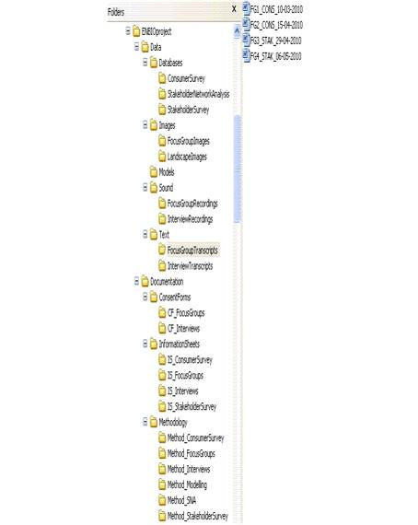
Directory Structure: Example
Image used with permission from the UKDA

Slide 15
What Format Should I Store my Data in? (Open Formats)
What is an Open Format?
  The specification has been published
  The format can be used and implemented by anyone
  e.g. csv or txt
Advantages of Open Formats
  Not limited to one piece of software
  More chance of being able to use the format in the future
Disadvantages
  Tend to be “simpler” and hold less information
UKDA table of Optimal File Formats

Slide 16
What Format Should I Store my Data in? (Lossless Formats)
What is a Lossless Format?
  Data is compressed without any being lost
  Lossy compression formats discard data in the compression process
  Used for preservation/archiving purposes
  E.g., TIFF, PDF/A, MPEG, FLAC
Advantage of Lossless Formats
  The original data can be recreated as none has been lost

Slide 17

Potential Issues with File Formats
Size of files – Lossless formats tend to be larger (because they hold more information about the file)
Version control – if the file is stored in more than one format do you update both formats when you make changes?
Storage – at least one back up (and/or the master copy) should be kept separate to your working data
Make sure you don’t lose important information when migrating formats
Files may not open in older/newer versions of the software (Nvivo example)

Slide 18
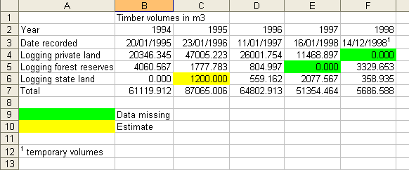
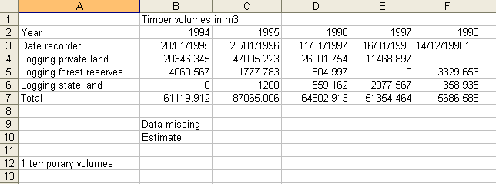
Example: Format Conversion
MS Excel format
Loss of annotation
Tab–delimited text format

Slide 19

Exercise
Think of the data formats you have used during your research:
  Could you open them without specific software?
  Why have you used those formats?
  Could you use other formats without losing information?
  Have you ever had problems with opening files from either other researchers or that you had created previously?

Slide 20
Data Storage 1
  Where will you be working: at home; in the office; fieldwork; all three?
  Will you be working collaboratively (does the data need to be shared)?
    Is the data covered by the Data Protection Act or ethics approval?
U:Drive – up to 20GBs allowance
Cloud storage (but not for sensitive or confidential data)
Computer hard drive
External hard drives & USB sticks
DVDs/CDs
Hard copy of documents

Slide 21
Data Storage 2
File formats and physical storage media become obsolete:
All digital media are fallible
Never assume the format will be around for ever.
Storage strategy best practice:
At least two storage formats.
Some proprietary data formats such as MS Excel are likely to be accessible for a reasonable, but not unlimited, time.
Maintain original copy, external local copy and external remote copy.
Copy data files to new media two to five years after first created.
Check data integrity of stored data files regularly (checksum e.g. FastSum).

Slide 22
Encryption
Encrypt anything you would not send on a postcard
for moving files e.g. transcripts
for storing files e.g. shared areas, mobile devices
Free software that are easy to use:
  Safehouse
  Axcrypt
  7zip
Encrypt portable storage devices e.g. USB flash drives
All University laptops should be encrypted (http://as.exeter.ac.uk/it/infosec/encryptionforlaptops/)

Slide 23
Back-Up Strategy
Know your institutional and personal back-up strategy:
What’s backed-up? - all, some data?
Where? - original copy, external local and remote copies
What media? - CD, DVD, external hard drive, tape, etc.
    Use a different medium to where you data is stored
How often? – assess frequency and automate the process
For how long is it kept?
Verify and recover - never assume, regularly test a restore
Make sure you know which version is the most up to date

Slide 24
Further Information
University of Exeter Pages on Research Data Management
UoE Open Access Research and Research Data Management Policy for PGR Students
UoE Open Access Research and Research Data Management Policy
UKDA – Organising Data
UKDA Table of Optimal File Formats

Slide 25

Any questions?
Contact us:
openaccess@exeter.ac.uk

