Slide 1

Benefits of Open Access
Sabina Leonelli
Department of Sociology and Philosophy, Egenis
s.leonelli@exeter.ac.uk

Slide 2
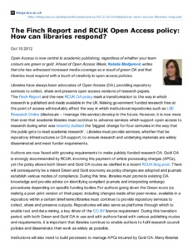
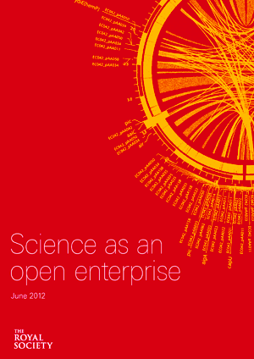

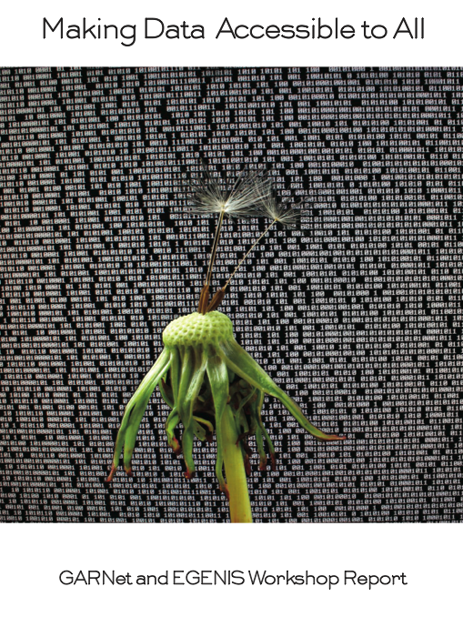

Slide 3
Openness: fundamental scientific value
Communication as key to training and learning
Enhances visibility and reputation of research(ers)
Guarantees transparency against possible fraud or controversy (e.g. ClimateGate)
Encourages replicability and re-use of knowledge (best form of testing and advancement)
Particularly important when research is publicly funded

Slide 4
Notoriously difficult to implement.. Until now
Intellectual property issues
Commodification of knowledge
Competition among researchers
Copyright issues implemented by publishing industry
Importance of keeping results for checks and validation
Results as fruits of scientific labour and significant investment
Also: Practical ways of disseminating results

Slide 5
Historical precedents
For advantages of OA:
Natural history collections and the origins of taxonomy and Darwinism
Research on Arabidopsis thaliana and C. elegans: immensely successful thanks to ethos of pre-publication sharing
Crowdsourcing initiatives, increasingly successful in advancing science while also involving non-scientists and giving idea of how science work
For problems with ‘closed’ science:
Corporate research: increasingly sharing data, as risk of ‘wasting’ data because of under-use and wrong formats is too great
ClimateGate..

Slide 6
Note: free versus open
Free access does not guarantee free re-use
Open = making it possible for others to access and re-use your knowledge/data (with appropriate acknowledgment)
Creative Commons licenses, Copyleft: guarantees authorship while encouraging re-use

Slide 7
Royal Society: ‘intelligent’ openness
Making papers and data available for re-use means thinking through how others will retrieve the information that they seek
Requires lots of labour and intelligence to structure information so that others can access and use it easily
Coming soon: compulsory submission of keywords for data upon publication of results (e.g. New Phytologist, Nucleic Acids Review); re-structuring of publications so that they are interactive documents and not PDFs (e.g. eLife by Wellcome Trust)

Slide 8
Get involved
Contribute your publications to ERIC via Symplectic
Contribute to field-specific repositories (e.g. ResearchGate, Academia.edu, PhilPapers) or general data-sharing repositories (Figshare, DataCite, Dryad)
Promote culture of sharing in your groups/labs/students
Pressure the University of Exeter to make Symplectic work for you, as it can and should do; and to invest more in Open Access support
Consider sharing your data, as well as your publications, through online repositories and databases; plan to make time for it!

