Slide 1
Decision Support System for the
Long-Term City Metabolism Planning Problem
Work Package 54
Mark Morley, Diogo Vitorino,
Kourosh Behzadian, Rita Ugarelli,
Zoran Kapelan, Sergio Coelho
& Maria Do Céu Almeida

Slide 2
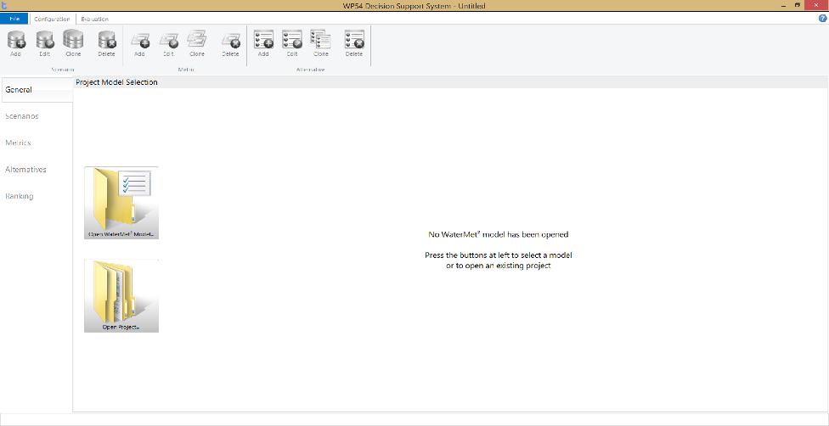
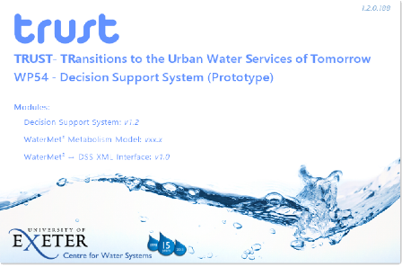
DSS Overview
DSS Aim:
Identify optimal strategic intervention strategy(ies) from a list of pre-defined strategies specified over a fixed long-term planning horizon by using pre-specified evaluation
criteria with associated targets
and preferences
DSS Technology:
Interactive GUI guiding user
through the process step by step.
Two complementary implementations:
    Web-based
    Desktop (Microsoft Windows)
Pre-built WaterMet² model used to evaluate (most) criteria
MCDA based ranking of specified intervention strategies (Compromise Programming and the Analytical Hierarchical Process)

Slide 3
DSS Structure
Desktop Interface
(Microsoft Windows)
Web Interface
Baseform Platform
DSS XML Interface
Performance
(WaterMet²)
Environment
Strategy
Notes:
The DSS is implemented as a three-tier application.
The twin user interfaces communicate with an XML-driven middleware layer which, in turn, marshalls data requests and commands to the backend of the DSS which is common to all versions of the software:
Environment package is responsible for configuring the problem for analysis in the DSS.
Performance package with its integrated version of WaterMet² (WP33) allows a particular system configuration performance to be quantified
Strategy package performs the MCDA ranking of the alternatives

Slide 4
DSS Principal Stages
Define problem
  Define scenarios, intervention strategies and evaluation criteria (including preferences and targets).
Populate decision matrix with values
  Run WaterMet² to calculate (and/or manually enter) the criteria values for all intervention strategies.
Rank and view results
  Perform multiple rankings for different scenarios and/or criteria preferences and identify best solution.
Modify and re-evaluate (if desired)
  Re-iterate (from step 1) until satisfied with the selected intervention strategy.
Define
Populate
Rank

Slide 5
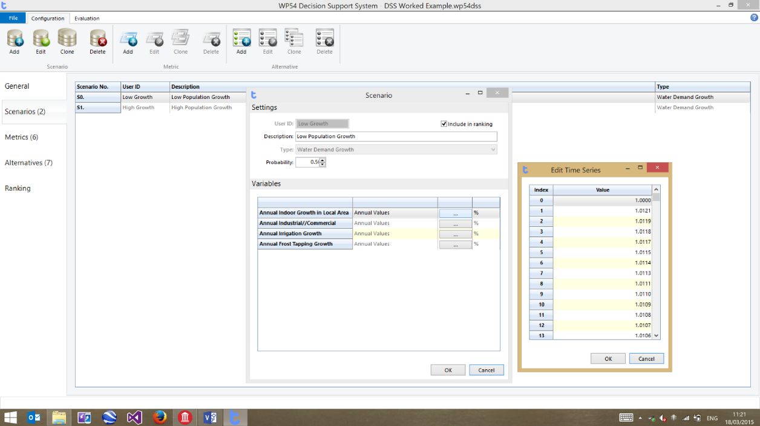
Scenarios
Scenarios represent any anticipated external changes in the surrounding environment and/or society over the analysed planning horizon.
Four types of scenarios are supported in the DSS developed in WP54 to cover variables associated with water demand growth, urbanisation, climate change and infrastructure ageing.
Define
Populate
Rank

Slide 6
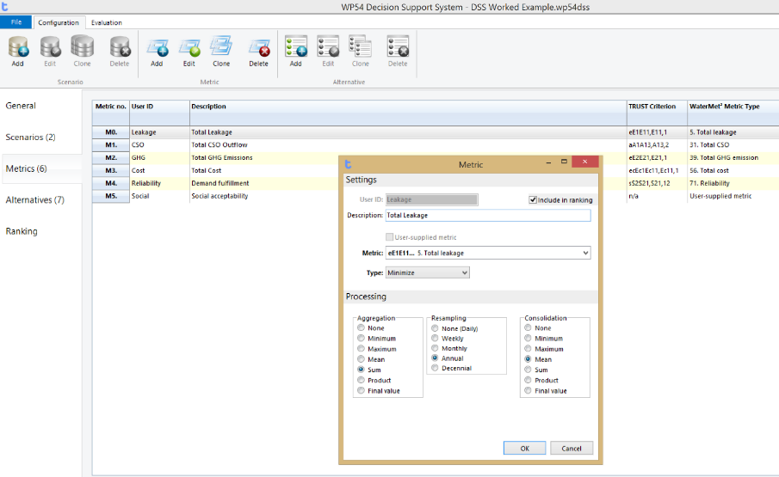
Metrics
The performance metrics used in the DSS are derived from those developed as part of the TRUST Sustainability Framework (Alegre et al., 2012) and cover five dimensions: social, environment, economic, governance and assets.
The DSS supports quantitative metrics calculated by the WaterMet² metabolism model along with user-defined qualitative metrics and quantitative metrics supplied by external tools.
Define
Populate
Rank

Slide 7
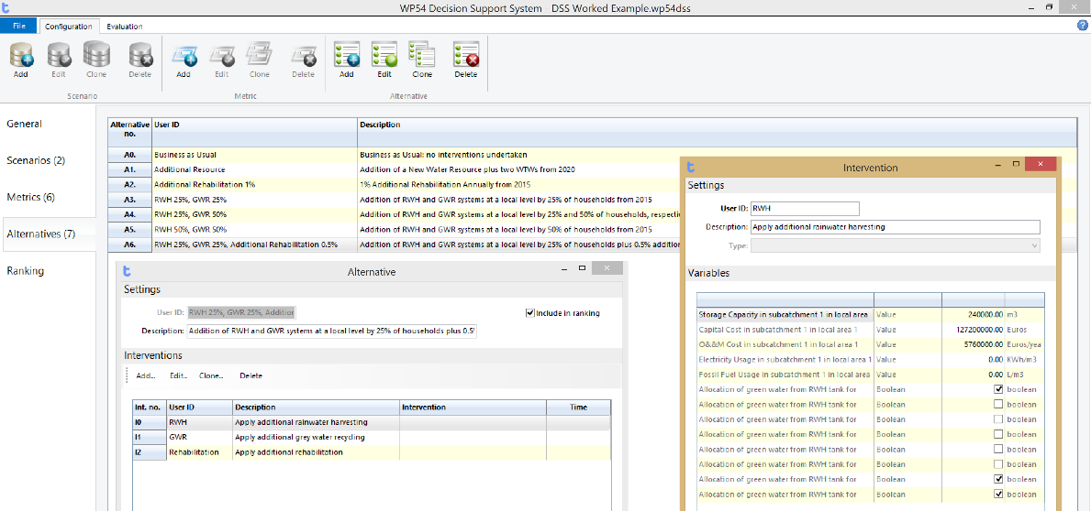
Alternatives
An Alternative (or intervention strategy) is defined as a set of individual interventions, each applied at pre-specified point in time over the planning horizon.
The DSS permits custom Alternatives to be configured using any of the individual interventions supported by the WaterMet² model. Each intervention may have a number of associated variables (e.g. cost, duration, GHG emissions, etc.) which can be specified for each individual instance of an intervention.
Define
Populate
Rank

Slide 8
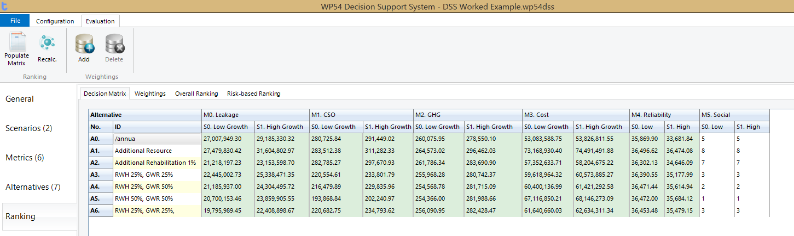
Decision Matrix
Population of the decision matrix is undertaken by:
Automated, repeated runs of the WaterMet² model to determine the quantitative metric values for each combination of Scenario and Alternative under consideration
Manual entry of any qualitative metric values or qualitative values calculated by external tools.
Define
Populate
Rank

Slide 9
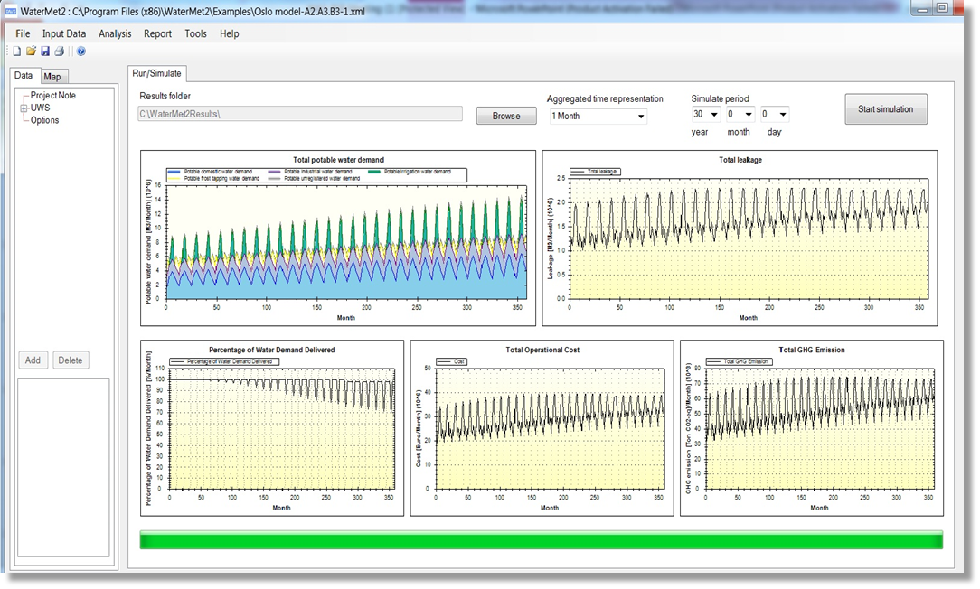
WaterMet² Run
Run WaterMet² internally to obtain metric values:
Modify relevant input
variables to represent
individual
interventions within
the Alternative being
evaluated
Run WaterMet² model
Aggregate the
obtained performance metrics according to user specified preference to obtain a single metric value for the planning horizon
Define
Populate
Rank

Slide 10
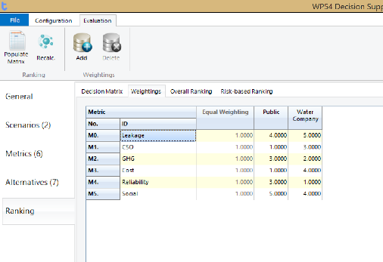
Stakeholder Perspectives
The DSS accommodates the differing preferences of stakeholders by allowing the specification of an unlimited number of weightings for each of the metrics being considered.
This allows the stakeholders to specify a relative preference to each of the metrics to be considered in the Compromise Programming MCDA ranking.
Similarly, multiple pair-wise comparison sets can be used to define stakeholder preferences when
using the AHP ranking
technique.
Define
Populate
Rank

Slide 11
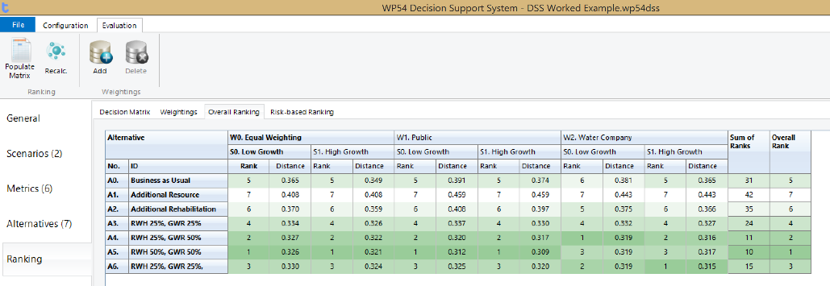
MCDA Ranking
Final ranking of the entries in the Decision Matrix produces a ranking table in which each Alternative is ranked for each combination of Scenario and Stakeholder preferences (Weightings).
The final ranks for each combination are aggregated and an overall ranking produced for the Alternatives. The results are presented in a colour-coded table allowing easy identification of the best Alternatives for each set of conditions.
Define
Populate
Rank

Slide 12
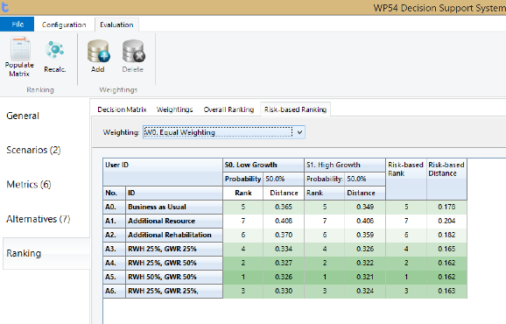
Cross-Scenario Risk-Related ranking
An extension of the risk methodology described in Deliverable D32.1 is applied in the DSS to further rank alternatives according to risk across the different scenarios.
This approach requires the likelihood of each given scenario to be assessed a priori and uses the distance calculated by the Compromise Programming MCDA method to assess the deviation of each alternative from the
desired sustainability
objectives.
Define
Populate
Rank

Slide 13
DSS Summary
DSS for strategic long-term planning of UWS
Supports multiple scenarios, alternatives, metrics and stakeholders’ preferences
Has a built-in library of above but also supports user specified input
Link to WaterMet2 although could be used without it
Flexible tool that could be used for solving other real-life problems

