Slide 1
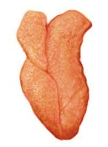
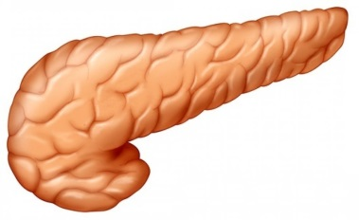
Immune Regulation
Autoimmune Destruction
_
Thymus
AIRE
Negative selection
+
ITCH
+
Activation
Proliferation
Infiltration and destruction of
target
(e.g. Pancreas)
Naïve
T-cell
[STAT1]
+
Self-reactive
T-cell
Development
+
+
STAT3
_
Suppression
_
FOXP3
Differentiation
LRBA
IL2RA
FOXP3
_
_
Regulatory
T-cell
Notes:
In organ specific autoimmune disease – Loss of AIRE prevents deletion of SR T cells. STAT3 has a role in the development of SR t cells in normal fucntion, although in disease this is not clear. loss of FOXP3 prevents their development. Loss of LRBA/IL2RA/FOXP3 decreases or abrogates their suppressive function. Loss of ITCH prevents downregulation of the TCR. STAT1 has a putative role in both the proliferation and activation of SR t cells.

Slide 2
_
Thymus
AIRE
Negative selection
+
ITCH
+
Activation
Self-
reactive
T-cell
Naïve
T-cell
Development
+
STAT3
_
Suppression
_
FOXP3
Differentiation
LRBA
IL2RA
FOXP3
_
_
Regulatory
T-cell
Notes:
In organ specific autoimmune disease – Loss of AIRE prevents deletion of SR T cells. STAT3 has a role in the development of SR t cells in normal fucntion, although in disease this is not clear. loss of FOXP3 prevents their development. Loss of LRBA/IL2RA/FOXP3 decreases or abrogates their suppressive function. Loss of ITCH prevents downregulation of the TCR. STAT1 has a putative role in both the proliferation and activation of SR t cells.

