Slide 1
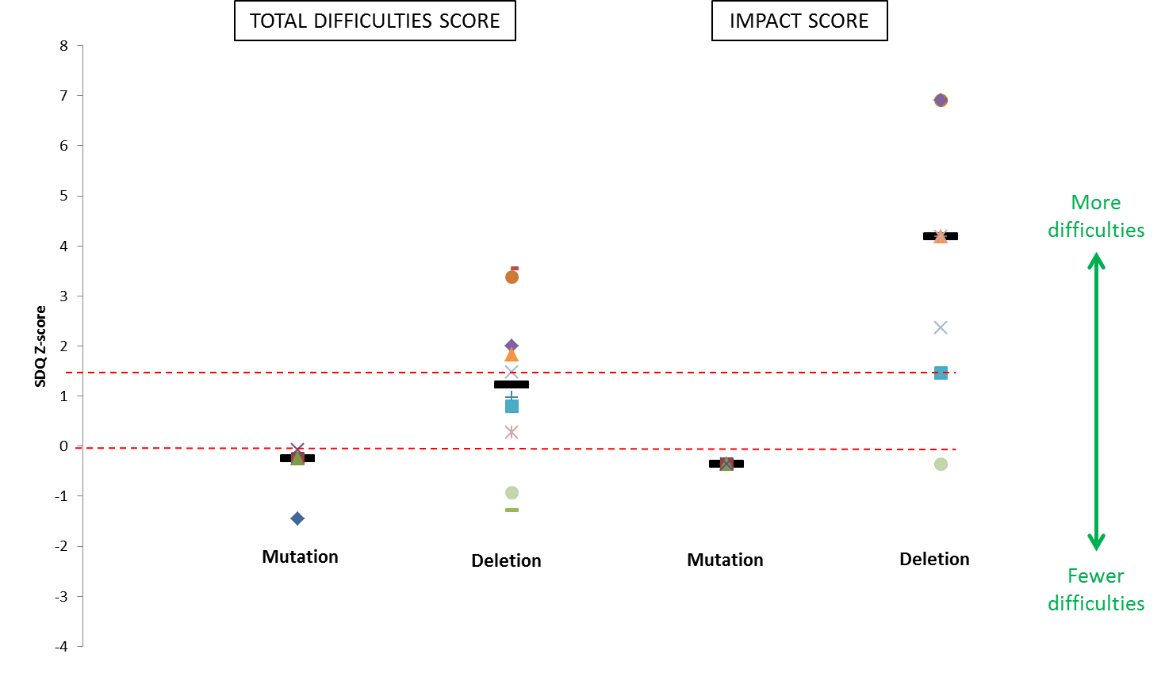
Figure 1
Notes:
Figure 1 Patient difficulties as shown by parent-report Strengths and Difficulties Questionnaire (SDQ) scores (presented as Z-scores) for individuals <18 years with both HNF1B gene mutations (n=4) and 17q12 microdeletions (n=10). Individual scores are represented as different-shaped points and group medians as black bold horizontal lines. X axis represents school-age population mean, red dashed horizontal line above represents suggested clinical cut-point (90th percentile).

Slide 2
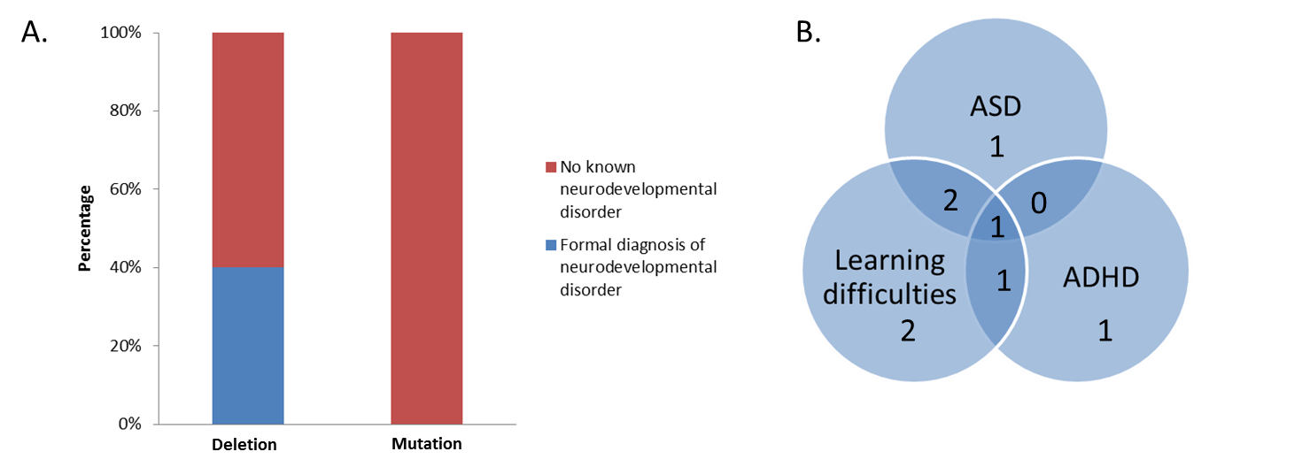
Figure 2
Notes:
Figure 2 (A) Stacked bar chart showing percentage of patients within both 17q12 microdeletion (n=20) and HNF1B mutation (n=18) groups with a known neurodevelopmental disorder including autism spectrum disorder (ASD), attention deficit hyperactivity disorder (ADHD) and/or learning difficulties requiring a Statement of Special Educational Needs or attendance at a special school. (B) Venn diagram illustrating the breakdown and overlap of diagnoses in the eight patients with a deletion and neurodevelopmental disorder.

Slide 3
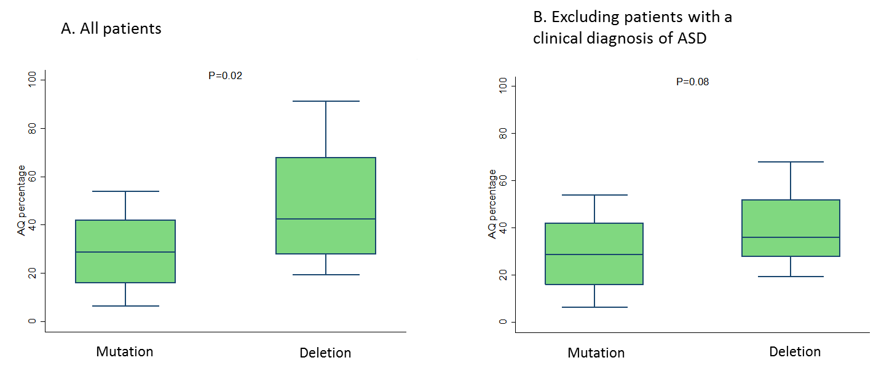
Figure 3
Notes:
Figure 3 Quantification of autistic traits using the Autism Spectrum Quotient (AQ) in individuals with HNF1B-associated disease of normal intelligence (defined as IQ >69). (A) Inclusion of all study patients with IQ >69 (n=36). (B) Exclusion of patients with a clinical diagnosis of an autism spectrum disorder (ASD; n=33).

Slide 4
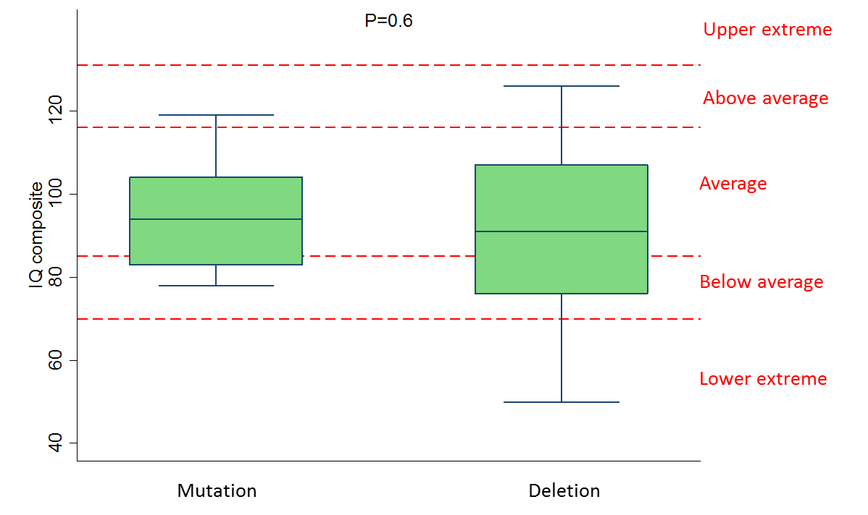
Figure 4
Notes:
Figure 4 Intelligence quotient (IQ) composite scores in individuals with HNF1B-associated disease. Different IQ classifications are shown by the red dashed horizontal lines.

Slide 5
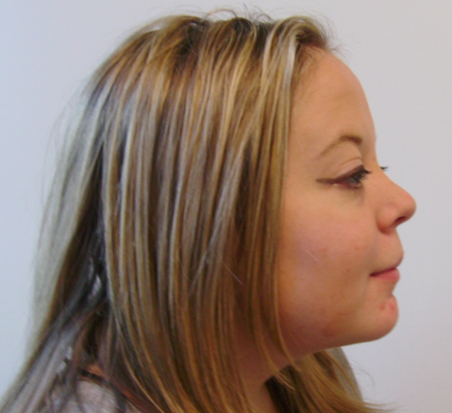

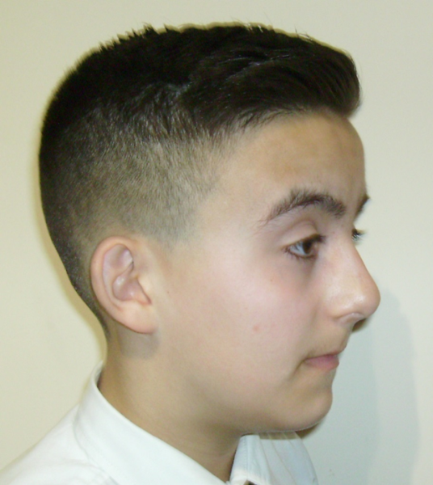
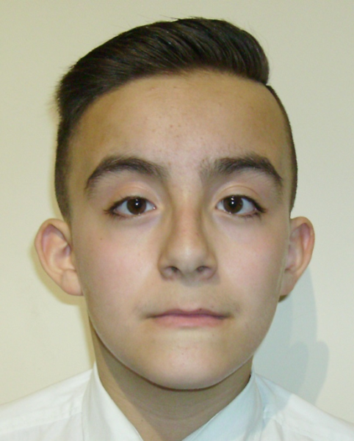
Figure 5
Notes:
Figure 5 Photographs of 2 study patients with a known HNF1B whole-gene deletion demonstrating the high forehead, high arched eyebrows, long philtrum, long face and anteverted nares that, taken as a whole, suggest the presence of a deletion

