Slide 1
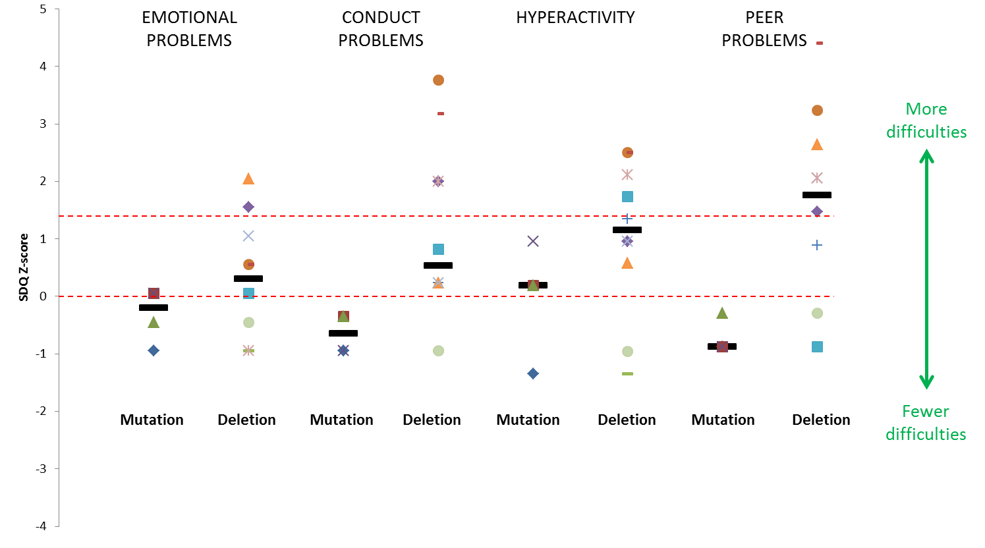
Supplementary Figure 1
Notes:
Supplementary Figure 1 Patient difficulties as shown by subsections of the parent-report Strengths and Difficulties Questionnaire (SDQ) scores (presented as Z-scores) for individuals <18 years with both HNF1B gene mutations (n=4) and 17q12 microdeletions (n=10). Individual scores are represented as different-shaped points and group medians as black bold horizontal lines. X axis represents school-age population mean, red dashed horizontal line above represents suggested clinical cut-point (90th percentile).

